Slide 1
Course: DS5002 Data Science Tools and Techniques
Data Preprocessing
Dr. Safdar Ali
Explore and discuss the process of data cleaning, with understanding of its importance, common challenges, and effective techniques along with data transformation.

Slide 2
Data Normalization
It is a process of adjusting values in a dataset so they fall within a particular range, typically between 0 and 1, or to have a certain statistical property, such as a mean of 0 and standard deviation of 1.
It ensuring that no feature dominates the others due to its scale, which is particularly important in many machine learning algorithms.

Slide 3
Why Data Normalization?
Feature Scaling: Many algorithms (e.g., k-nearest neighbors, gradient descent) rely on distance metrics, which can be heavily affected by the scale of features. Features with large numerical ranges can dominate the calculation of distances.
Improving Algorithm Performance: Normalization can improve the convergence of gradient descent algorithms and increase the accuracy of machine learning models.
Handling Units: Features in a dataset can have different units (e.g., age in months, years), and normalization ensures they are on the same scale.

Slide 4
Methods for Normalizing Data
Min-Max Scaling (Rescaling)
Z-score Normalization (Standardization)
Robust Scaler
Log Transformation

Slide 5
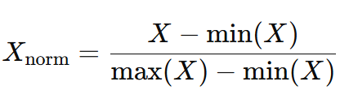
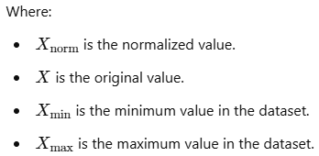
Min-Max Scaling (Rescaling)
Transforms data into a fixed range, typically [0, 1].
Formula:
Benefits: It is very simple and scales all features to the same range.
Drawbacks: Sensitive to outliers, as outliers can affect the minimum and maximum values.

Slide 6

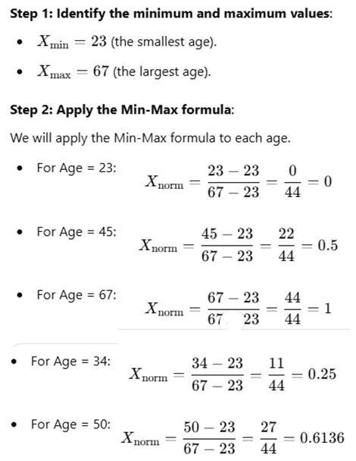
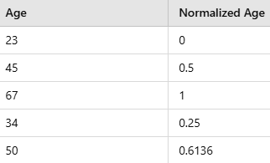
Example
Consider a small dataset of ages
Apply Min-Max Scaling to normalize the ages to the range [0, 1]
Normalized Data
Insights
After applying Min-Max scaling, the "Age" feature has been rescaled to fall between 0 and 1

Slide 7
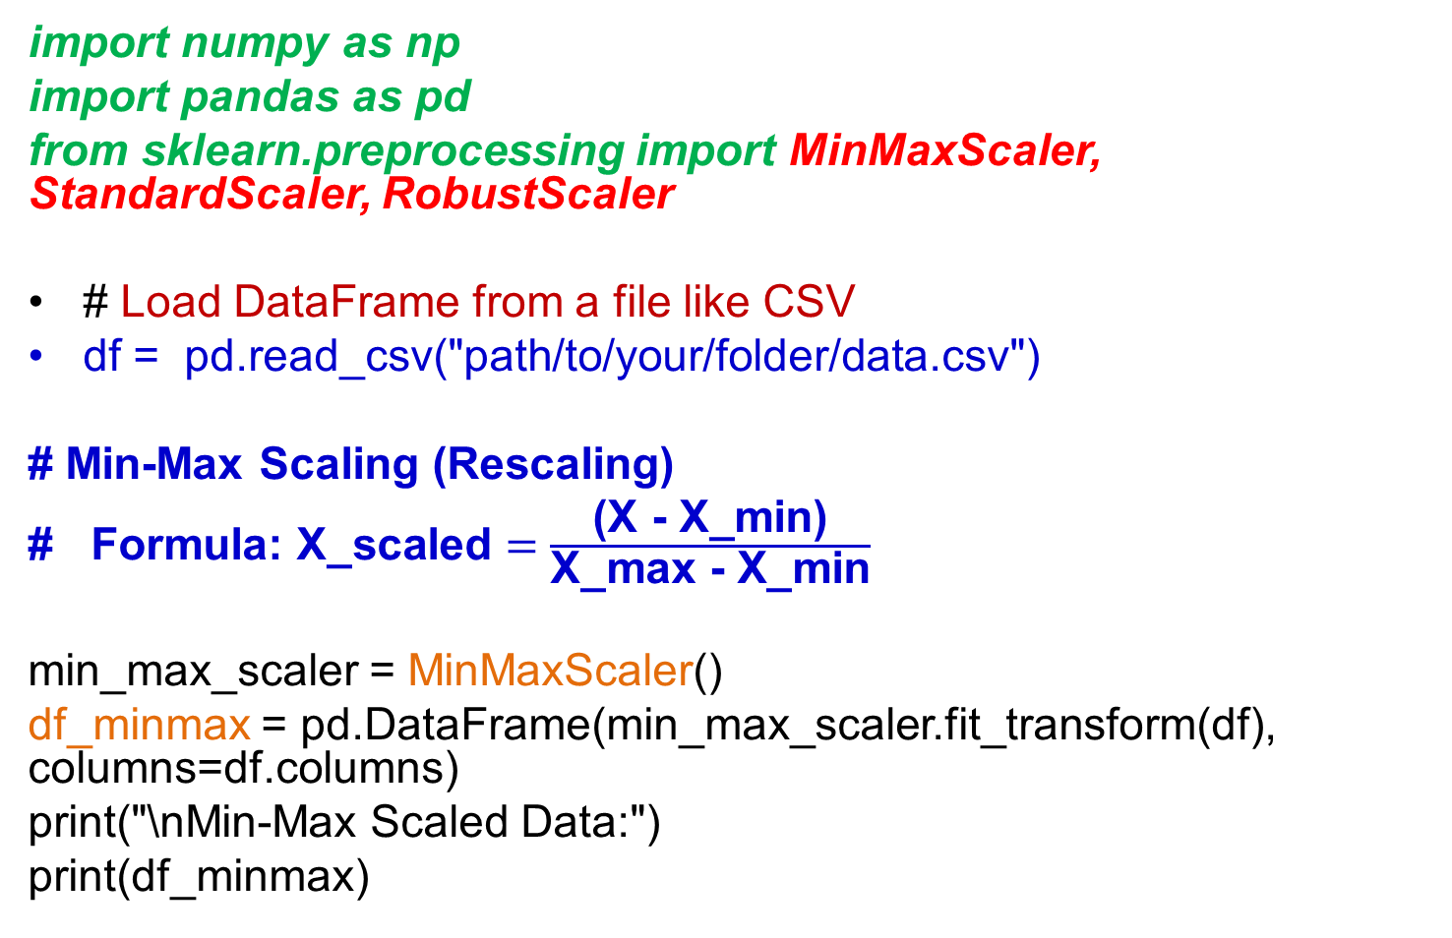
Min-Max Scaling (Rescaling)
import numpy as np
import pandas as pd
from sklearn.preprocessing import MinMaxScaler, StandardScaler, RobustScaler
# Load DataFrame from a file like CSV
df = pd.read_csv("path/to/your/folder/data.csv")
# Min-Max Scaling (Rescaling)
# Formula: $\text{X}\text{_}\text{scaled}=\frac{\text{(}\text{X}\text{ − }\text{X}\text{_}\text{min}\text{)}}{\text{X}\text{_}\text{max}\text{ − }\text{X}\text{_}\text{min}}$
min_max_scaler = MinMaxScaler()
df_minmax = pd.DataFrame(min_max_scaler.fit_transform(df), columns=df.columns)
print("\nMin-Max Scaled Data:")
print(df_minmax)

Slide 8
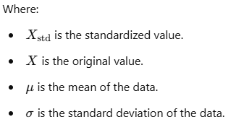
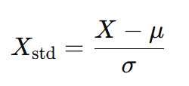
Z-score Normalization (Standardization)
Transforms data so that it has a mean of 0 and a standard deviation of 1.
Formula:
Benefits: Less sensitive to outliers than Min-Max scaling, and it’s suitable for algorithms that assume a Gaussian distribution of the data.
Drawbacks: Not always effective if the data is not normally distributed.

Slide 9
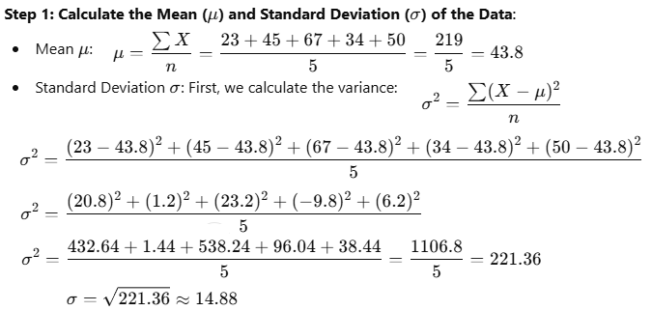
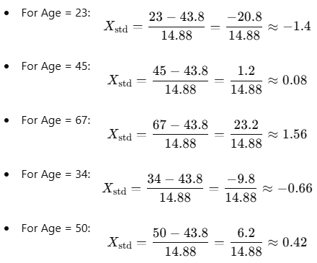
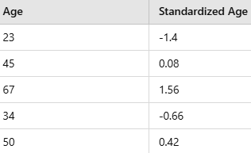
Example
Apply Z-score normalization to ages dataset
Standardized Data
Insights
After applying Z-score normalization, the "Age" feature has been standardized to have a mean of 0 and a standard deviation of 1.

Slide 10
Z-score Normalization (Standardization)
# Load DataFrame from a file like CSV
df = pd.read_csv("path/to/your/folder/data.csv")
# Z-score Normalization (Standardization):
# Formula: X_standardized = (X - mean) / std_dev
standard_scaler = StandardScaler()
df_standardized = pd.DataFrame(standard_scaler.fit_transform(df), columns=df.columns)
print("\nZ-score Normalized Data:")
print(df_standardized)

Slide 11
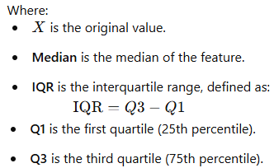
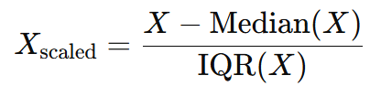
Robust Scaler Method
It uses the median and the interquartile range (IQR) for scaling, making it robust to outliers.
Formula:
Benefits: Works well when data contains many outliers.
Drawbacks: It may not work as well when the data distribution is highly skewed.
Transforms the data into a range where the data is centered, with robust scaling values often falling between -1 and 1, but the presence of outliers can push values beyond that range.

Slide 12

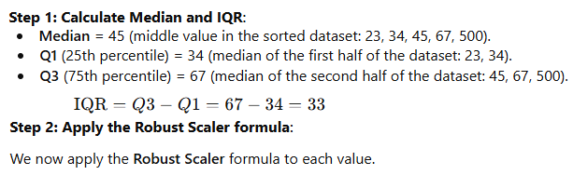
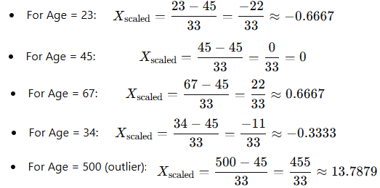
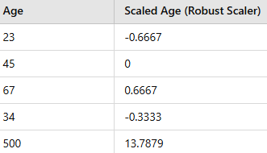
Example
Consider ages dataset for some extreme outliers:
Scaled Data
Insights
Robust Scaler centers the data around the median and scales it by the IQR.

Slide 13
Robust Scaler
# Robust Scaler:
# Uses median and interquartile range, robust to outliers
robust_scaler = RobustScaler()
df_robust = pd.DataFrame(robust_scaler.fit_transform(df), columns=df.columns)
print("\nRobust Scaled Data:")
print(df_robust)

Slide 14

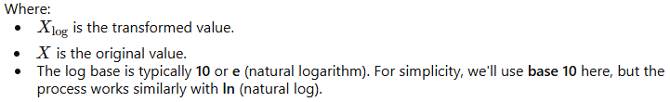
Log Transformation
Simple transformation used to reduce the effect of large values by applying a logarithmic function to each value in the dataset.
Formula:
Benefits: Effective in dealing with positively skewed data.
Drawbacks: Only applicable to positive values.
The log transformation is used to reduce skewness in a dataset by compressing the range of values. It is particularly useful for datasets where the values span several orders of magnitude or when the data is highly right-skewed

Slide 15

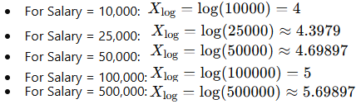
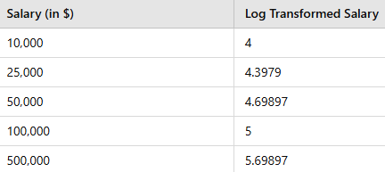
Example
Consider a salary dataset with a few values:
Right-skewed due to the large salary values at the top (e.g., 500,000)
Apply the log transformation to each salary
Log Transformed Data
Insights
1.Compresses large values and makes distribution more normal (i.e., reduces skewness).
2.Particularly useful for right-skewed data (data with extreme high values).
3.After applying log transformation, data values become more evenly distributed and the extreme values (outliers) have less influence.

Slide 16
Log Transformation
# Log Transformation
# Helps normalize skewed data by applying log function
# Adding 1 to avoid log(0) issue, as log(0) is undefined
# This ensures that all values remain positive before applying log transformation
# log1p(x) function is equivalent to log(1 + x), which is useful when dealing with zero or very small values
df_log = np.log1p(df)
print("\nLog Transformed Data:")
print(df_log

Slide 17
import numpy as np
import pandas as pd
from sklearn.preprocessing import MinMaxScaler, StandardScaler, RobustScaler
# Load DataFrame from a file like CSV
df = pd.read_csv("path//data.csv")
df = pd.DataFrame(data)
# 1. Min-Max Scaling (Rescaling):
# Formula: X_scaled = (X - X_min) / (X_max - X_min)
min_max_scaler = MinMaxScaler()
df_minmax = pd.DataFrame(min_max_scaler.fit_transform(df), columns=df.columns)
print("\nMin-Max Scaled Data:")
print(df_minmax)
# 2. Z-score Normalization (Standardization):
# Formula: X_standardized = (X - mean) / std_dev
standard_scaler = StandardScaler()
df_standardized = pd.DataFrame(standard_scaler.fit_transform(df), columns=df.columns)
columns=df.columns)
print("\nZ-score Normalized Data:")
print(df_standardized)
# 3. Robust Scaler:
# Uses median and interquartile range, robust to outliers
robust_scaler = RobustScaler()
df_robust = pd.DataFrame(robust_scaler.fit_transform(df), columns=df.columns)
print("\nRobust Scaled Data:")
print(df_robust)
# 4. Log Transformation:
# Helps normalize skewed data by applying log function
# Adding 1 to avoid log(0) issue, as log(0) is undefined
# This ensures that all values remain positive before applying log transformation
# log1p(x) is equivalent to log(1 + x), which is useful when dealing with zero or very small values
df_log = np.log1p(df)
print("\nLog Transformed Data:")
print(df_log)

Slide 18
Where to Use Normalization?
Distance-based Algorithms: Algorithms like KNN, SVM, and k-means clustering rely on distance measures, so normalization is essential.
Gradient Descent: Linear regression, logistic regression, and neural networks benefit from normalized data because it helps in faster convergence of the optimization process.
Principal Component Analysis (PCA): Normalization is required to ensure that the data is centered and scaled before performing dimensionality reduction.

